Slide 1
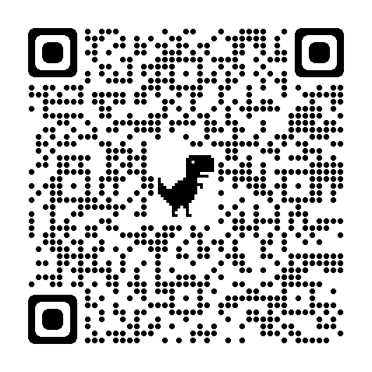
Converting Your Media Center to a Museum

Slide 2
FL State Statutes
The 2022 Florida Statutes
1003.42 Required instruction
http://www.leg.state.fl.us/statutes/index.cfm?App_mode=Display_Statute&URL=1000-1099/1003/Sections/1003.42.html

Slide 3
FL State Statutes
h) The history of African Americans, including the history of African peoples before the political conflicts that led to the development of slavery, the passage to America, the enslavement experience, abolition, and the history and contributions of Americans of the African diaspora to society. Students shall develop an understanding of the ramifications of prejudice, racism, and stereotyping on individual freedoms, and examine what it means to be a responsible and respectful person, for the purpose of encouraging tolerance of diversity in a pluralistic society and for nurturing and protecting democratic values and institutions. Instruction shall include the roles and contributions of individuals from all walks of life and their endeavors to learn and thrive throughout history as artists, scientists, educators, businesspeople, influential thinkers, members of the faith community, and political and governmental leaders and the courageous steps they took to fulfill the promise of democracy and unite the nation. Instructional materials shall include the vital contributions of African Americans to build and strengthen American society and celebrate the inspirational stories of African Americans who prospered, even in the most difficult circumstances. Instructional personnel may facilitate discussions and use curricula to address, in an age-appropriate manner, how the individual freedoms of persons have been infringed by slavery, racial oppression, racial segregation, and racial discrimination, as well as topics relating to the enactment and enforcement of laws resulting in racial oppression, racial segregation, and racial discrimination and how recognition of these freedoms has overturned these unjust laws. However, classroom instruction and curriculum may not be used to indoctrinate or persuade students to a particular point of view inconsistent with the principles enumerated in subsection (3) or the state academic standards. The department shall prepare and offer standards and curriculum for the instruction required by this paragraph and may seek input from the Commissioner of Education’s African American History Task Force.
(l) The history of the state

Slide 4
Examples
Black History
Holocaust

Slide 5
Florida Museum

Slide 6
Topics
Create a rotation on how many topics every few years-
Middle School 6-8 (3 topics for museum from the FL State Statutes)
High School 9-12 (4 topics for museum)
Elementary 3-5 (3 topics)
No repetition of topic for students
As a group- decide which topics need emphasis at your school
District, school

Slide 7
Who to work with?
Department heads (social studies, language arts teachers, science/math, foreign language, art, music?)
Classroom teachers (next slide)
Administration
Outside sources:
Holocaust task force- DOE (posters, trunk)
Local historians
Local universities
Florida History Museum (free FL folk music CDs)

Slide 8
Interactivity?
Does your school have the digital tools to make it more interactive?
Class set of ipads and headphones?
Create QR codes
Large screen and sound system for a short video upon entrance or exit?
Notes:
https://edtechmethods.com/tag/20-a1/

Slide 9
Classroom teachers
Buy in??
Power of choice
How do they WANT to show their student’s mastery of the general topic?
Create a master list of what their classes are doing (topic and project type)
Why? so there is no overlap or leave out major milestones
Ex) African American History- chronological? Civics- court cases?

Slide 10
Suggestions for Classroom teachers
Project types
Photos
Drawings
Posters
Poems
If access to technology (ipads and headphones)
Podcast (next slides)
Videos
Powerpoints
Microsoft Sway
https://sway.office.com/1K2B65B7MwklnYRn

Slide 11
Classroom teachers
Something for students to do before, during, and after the museum
Let classroom teachers decide if they want an assignment
Basic KWL chart
Knew topic ahead of time?
What you learned?
What you want to learn?

Slide 12
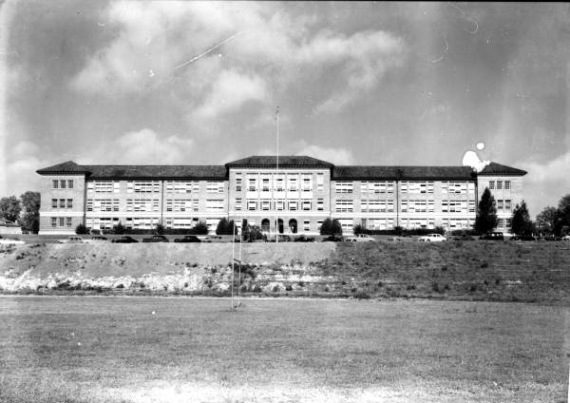
Teaching POdcasts
Allow students to listen to sample podcasts
NPR
What is the driving question?
Sub topic or an angle
Write a rough plan (or rough draft)
Allow time to record (phones, laptops)
Extra credit for expert witness interview
Audio editing software
Audacity
Integration of Leon High School by Nyla C.
Notes:
https://www.floridamemory.com/items/show/47883

